Slide 1
Managing External Environment
Jyoti

Slide 2
External Environmental Variables
Natural environment
Societal environment
    Task environment (Industry Analysis)

Slide 3
Scanning Natural environment:
It includes: Physical resources; Wildlife; Climate
These factors form an ecological system of interrelated life.
Physical Resources: availability of Raw material, land, fresh water and clean air.
Impact of Global warming on natural environment, such as sea level, weather, and climate, are becoming increasingly uncertain and difficult to predict.

Slide 4
Societal environment –
STEEP/ PESTEL Analysis
Societal environment- It is mankind’s social system that includes general forces that do not directly touch on the short-run activities of the organization that can, and often do, influence its long-run decisions. These factors affect multiple industries and are as follows:
  Economic factors: that regulate the exchange of materials, money, energy, and information.
  Technological factors: that generate problem-solving inventions
  Political-legal factors: that allocate power and provide constraining and protecting laws and regulations.
  Socio-cultural factors: that regulate the values and customs of society.

Slide 5
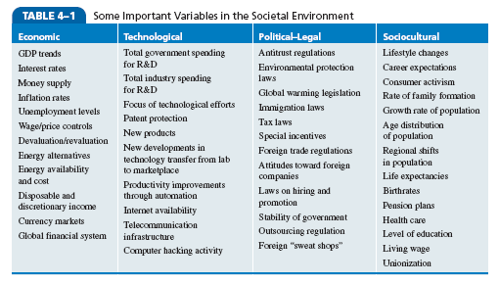
Some important variables in
Societal Environment:

Slide 6
Identifying External Strategic Factors:
Issues priority matrix- used to identify and analyze developments in the external environment
External strategic factors- key environmental trends that are judged to have both a medium to high probability of occurrence and a medium to high probability of impact on the corporation

Slide 7
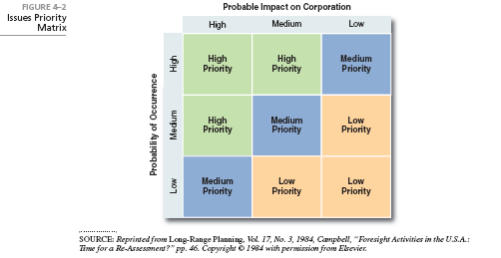
Issues Priority Matrix:

Slide 8
Task environment
Task environment- groups that directly affect a corporation and are affected by the corporation
Government
Local communities
Suppliers
Competitors
Customers
Creditors
Unions
Special interest groups/trade associations
A corporation’s task environment is typically the industry within which the firm operates.

Slide 9
Managing Stakeholder Relationships
Stakeholders: any constituencies in the organization’s environment that are affected by an organization’s decisions and actions.
Notes:
The nature of stakeholder relationships is another way in which the environment influences managers. The more obvious and secure these relationships, the more influence managers will have over organizational outcomes.
Stakeholders are any constituencies in the organization’s environment affected by an organization’s decisions and actions. These groups have a stake in or are significantly influenced by what the organization does. In turn, these groups can influence the organization.
Management researchers who have looked at this issue are finding that managers of high-performing companies tend to consider the interests of all major stakeholder groups as they make decisions.

Slide 10
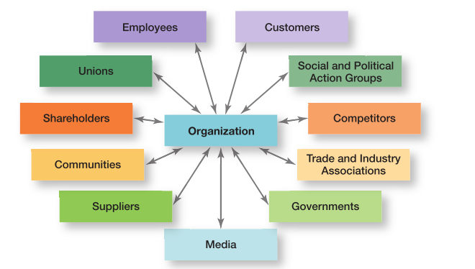
Organizational Stakeholders
Exhibit 3-4 identifies some of an organization’s most common stakeholders

Slide 11
Thank you

